Slide 1
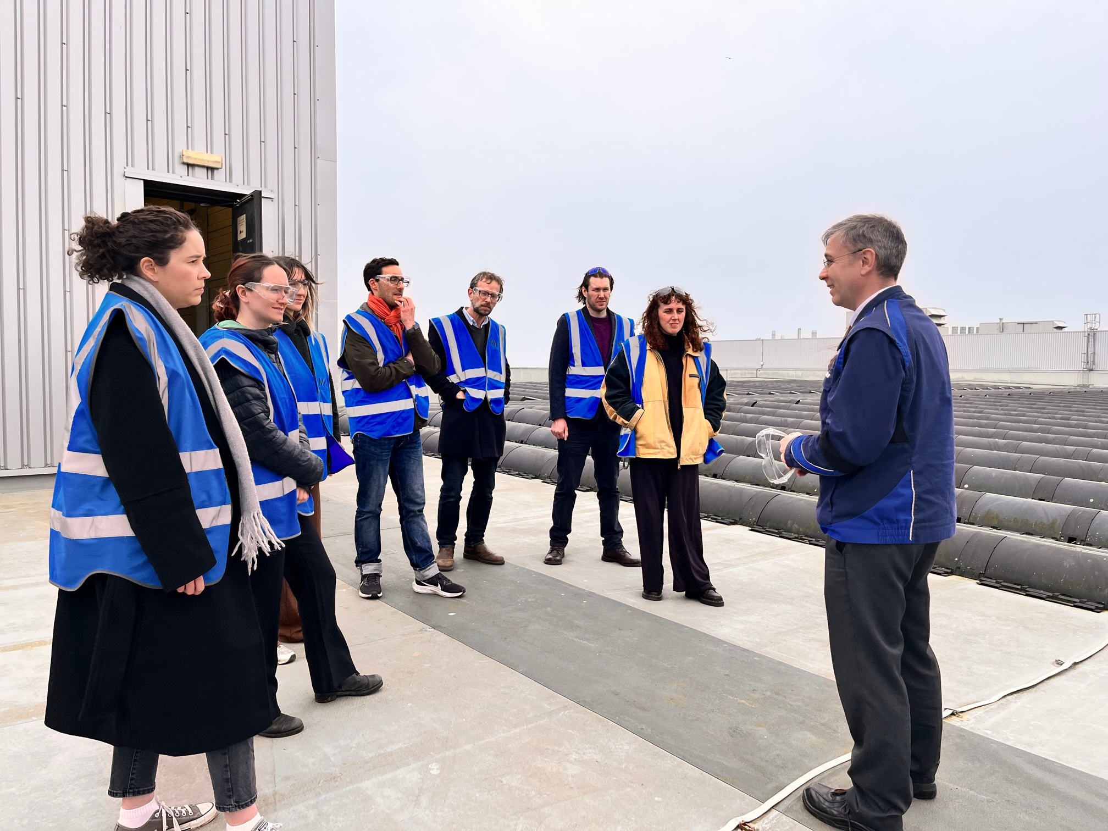
Project Summary
Zero Carbon Oxford Partnership - INDUSTRIAL DECARBONISATION

Slide 2
Project background

Slide 3
Introduction to this report, authors, and disclaimer
ABOUT ZCOP
Since 2021, Zero Carbon Oxford Partnership (ZCOP) and the supporting Secretariat have been working together to enable the city to meet its net zero targets and prepare for climate change impacts. Ou members include both universities, both NHS Trusts, the City and County Councils, further education bodies and large businesses such as BMW Mini, Lucy Group LandSec, SSEN and Unipart, as well as OxLEP and the Low Carbon Hub.
Together Partnership currently involves 21 organisations from 12 sectors, representing over 55,000 employees. It is a proactive network with an established and expanding value proposition.
Partnership members commit to:
Working to create a zero carbon and resilient Oxfordshire.
Working on shared projects that deliver greater carbon emission reductions than we could achieve individually.
Emphasising local, community and non-carbon benefits of climate action.
This project
ZCOP Oxfordshire
Building on the success of Zero Carbon Oxford Partnership, we are expanding to become a countywide body to drive collaborative climate action across Oxfordshire. We will build on this record of enabling partners to collaborate to accelerate climate action, harnessing our collective skills and powers expertise and – increasingly – new sources of funding, to accelerate local net zero projects.
ZCOP and the Oxford Industrial Cluster are keen to support other clusters to develop across the county, learning from our approach and experience from this project.
Industrial organisations are encouraged to contact the secretariat to learn more: ZCOP@Oxford.gov.uk
Disclaimer
This report was developed as part of the ZCOP Industrial Decarbonisation Roadmap Project led by Oxford City Council on behalf of the ZCOP Partnership. The conclusions and recommendations do not necessarily represent the view of any members of ZCOP. Whilst every effort has been made to ensure the accuracy of this report, neither ZCOP, OCC, or ERM warrant its accuracy or will, regardless of its or their negligence, assume liability for any foreseeable or unforeseeable use made of this report which liability is hereby excluded.
Funded by DESNZ through the Local Industrial Decarbonisation Plans (LIDP) grant

Slide 4
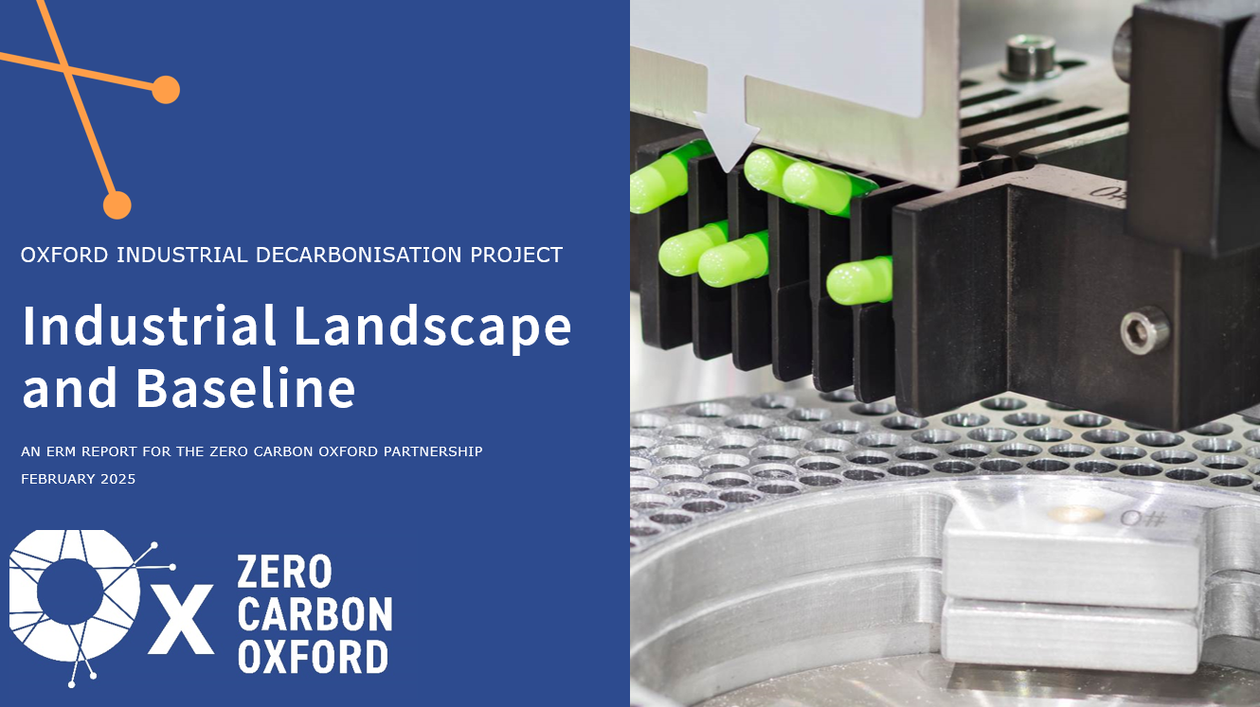
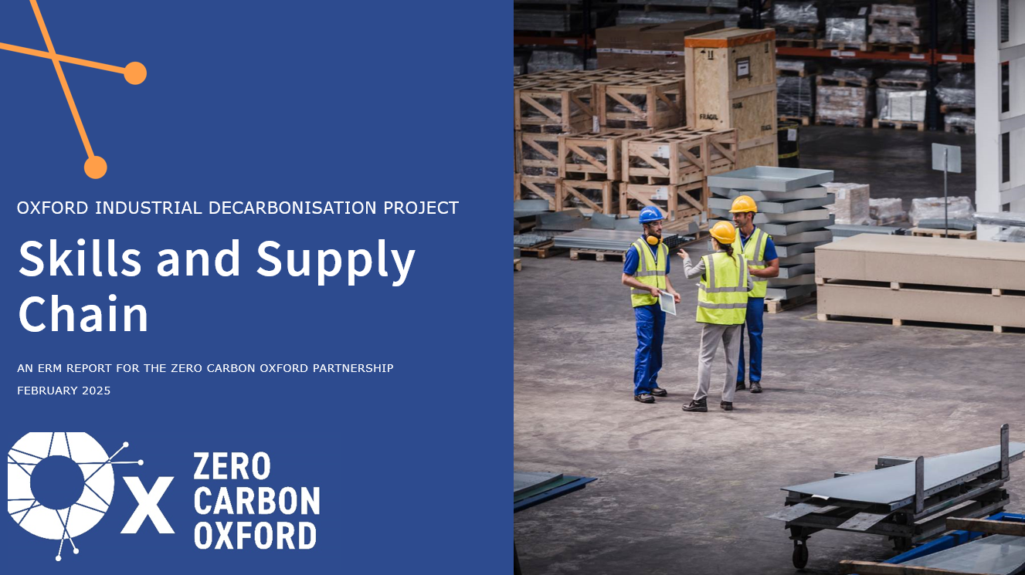
The roadmap & action plan was developed collaboratively and builds on several detailed supporting studies
This Oxford Industrial Decarbonisation Roadmap has been developed by Zero Carbon Oxford Partnership, ERM, and Oxfordshire Greentech following a series of detailed studies exploring the industrial cluster, its technological options for decarbonisation, the level of ambition required, and the barriers to be overcome.
Specific targets and actions were developed in collaboration with local councils, local industrials, energy providers, technology developers, and the investor community based on the findings from these supporting studies. Further details of the actions developed are included in future publications.
Key outcomes from the supporting studies are included as Supporting Evidence for this report, with the individual studies accessible on the ZCOP website late in the year. A summary of the methodology for each supporting study is included in an Appendix document.
Industrial Landscape & Baseline
Defined the Oxford industrial cluster, key sectors, locations, and processes.
Evaluated current energy consumption and emissions.
Identified future growth of the Oxford Industrial Cluster.
Technology Prioritisation
Reviewed possible decarbonisation technologies against criteria of technology readiness, cost, applicability, and a range of barriers.
Identified most appropriate technologies for Oxford industrials.
Scenario Modelling
Identified business-as-usual uptake for technologies and identified initiatives to accelerate uptake.
Developed Oxford industrial decarbonisation scenarios and technology uptake targets.
Evaluated impact of technology uptake on energy, emissions, costs, jobs & gross value added.
Funding and Financing
Identified barriers to funding and financing industrial decarbonisation in Oxford.
Explored options for enabling uptake of abatement technologies from a funding and financing perspective.
Skills and Supply Chain
Identified barriers to abatement technology uptake associated with skills and supply chains in Oxford.
Explored options for enabling uptake of abatement technologies from a skills and supply chain perspective.

Slide 5
Extensive engagement with local stakeholders ensured the findings of supporting studies were specific to Oxford needs
Stakeholder Engagement Methodology
Stakeholder database
Networking events
Surveys and energy audits
Technical workshops
The project developed a survey for industrial organisations to collect energy usage and demand data, and disseminated this to our database. The project also offered free energy audits to 10 organisations via ESOx.
The project including two open networking events and two site visits to engage the wider energy and business communities in Oxford, gather support for project activities, and facilitate strategic collaborations.
The project compiled a stakeholder database of around 300 contacts, containing information about Oxford’s industrials and other relevant stakeholders including contact details, size, and engagement.
The project held 9 workshops to inform key stakeholders of project developments and to gather their input into project modelling.
289
224
139
96
85
30
9
2
64
Contacts on stakeholder database
Attendees across all Events
Number of unique event attendees
Organisations engaged
Percentage of Oxford's known industrials engaged
tCO₂e reduction potential from energy audits
1-2-1 stakeholder interviews
Group workshops
Networking events

Slide 6
Executive summary

Slide 7
Oxford’s unique and innovative industrial landscape will require collaborative and pioneering decarbonisation solutions
We define the Oxford Industrial Cluster as organisations who manufacture, process, or produce goods in Oxford City Council, including the key sectors of high-tech engineering, life sciences, and automotives.
Oxford has one large industrial emitter – Mini Plant Oxford – with other sub-clusters of smaller industrial energy users concentrated in business parks, especially along the ring road in the South-East of Oxford.
The growing life sciences and advanced engineering sectors are driving the expansion of business parks across Oxford who are looking to accommodate university spin-outs and small and medium-sized enterprise (SMEs) in hybrid lab-office spaces.
These established and emerging industrial sub-clusters will require collective, integrated decarbonisation solutions to decarbonise their industrial processes.
The main industrial processes are characterised by low temperature and direct heating processes, such as gas-fired boilers, medical and lab equipment, food industry chillers, and direct heaters.
These processes offer opportunities to decarbonise via energy efficiency and management, electrification, heat networks, smart energy systems, and energy storage technologies.
Oxford’s motivated and innovative industrial basis is well-positioned to capitalise on the opportunities presented by the energy transition and emerge as a leader in low carbon energy solutions.
Based on this understanding of the scale, location, and processes leading to industrial emissions in Oxford this roadmap provides a clear vision for decarbonising Oxford’s industrial sites and outlines the enabling actions required to achieve this.
Map of industrial employment and sites in Oxford
Mini Plant Oxford & Unipart Logistics
Osney Mead Industrial Estate
ARC Oxford
Nuffield Industrial Park
Oxford Science Park

Slide 8
Local renewables, heat pumps, heat networks and process electrification are priority technologies for Oxford industrials
Individual technology assessments were used to prioritise technologies (based on technical considerations, economic factors, wider barriers in Oxford, and stakeholder views) for the range of industrial emission sources identified in Oxford. This includes electricity consumption, low temperature indirect heating (gas boilers), and complex heating* (e.g. ovens and kilns).
High priority solutions for Oxford industrials were identified as:
Energy management & efficiency measures, which will be critical across all processes and technologies, especially innovative and digital/smart solutions to help reduce peak demand and alleviate grid constraints.
Onsite renewables with energy storage for electricity supply (if space and capital are available) or external renewables via renewable energy procurement (if onsite renewables are not possible).
Accessing a decarbonised heat network or installing a heat-pump to provide low temperature indirect heating (e.g., space heating).
For complex heating at small loads, replacing natural gas equipment with an electrified alternative (e.g., e-boilers or microwave ovens) in cases where technologies are commercially available and where grid constraints are not a barrier. For complex heating at larger loads, the chosen solution is expected to be bespoke to the site.
Emerging technologies will play a crucial role across the full spectrum of solutions to increase feasibility, reduce cost, and enable integration of low carbon technologies.
Overview of technology prioritisation across industrial processes
Electricity Consumption
< 100°C Indirect Heating
Small Load
Complex Heating
Large Load
Complex Heating
High Priority
Energy management & efficiency
Onsite renewables
Heat networks
Process electrification
Bespoke solutions (site specific)
External renewables
Heat pumps
Energy storage
Low carbon gas switching
Grid decarbonisation
Carbon capture
High quality carbon removals
Low Priority
Lower priority solutions include:
Waiting and being reliant on grid decarbonisation, as UK-wide developments in electricity supply are outside of the Oxford Industrial Cluster’s control.
Carbon capture is deprioritised since it is not expected to be economical for Oxford industrials, and the region is not a focus for CO₂ transport infrastructure development.
High quality carbon removals are deprioritised since Oxford Industrial Cluster’s focus is on first achieving direct decarbonisation where possible.
*Complex heating refers to processes at >100°C or direct heating technologies.

Slide 9
Local initiatives can accelerate decarbonisation and reduce residual emissions, but an ambitious transformation is needed
Oxford industrial cluster emissions across scenarios explored compared to Oxford City’s target*
Many large industrials and business parks in Oxford have committed to decarbonisation, with ambitious plans for low-carbon technology deployments. However, several constraining factors might limit decarbonisation in a business-as-usual case, putting at risk the Oxford City target for net zero emissions by 2040.
Our enabled & locally driven scenario (consisting of initiatives to increase electricity capacity, expand Oxford’s heat network, and engage SMEs) shows how emission reductions could be accelerated and overall residual emissions reduced – achieving 66% reduction by 2035 and 90% reduction by 2040. This, however, requires an ambitious transformation of Oxford’s energy system and significant technology deployments – 45 MW of process electrification, 32 MW of decarbonised heat, from heat pumps or heat network connections, and 31 MW of local renewables.
Scope 1 & 2 Emissions (ktCO₂^{/y})
70
Business-as-Usual
60
Enabled & Locally Driven
50
Speculative
40
Industry Target
30
20
Business-As-Usual Scenario
The business-as-usual case explores industrial decarbonisation in Oxford in a case without further intervention outlined by the actions of this roadmap. Technology uptake is driven by existing plans or national policies and is constrained by barriers such as limited grid capacity, lack of space for onsite renewables, and barriers to engagement for SME industrials.
10
Enabled & Locally Driven Scenario
Speculative Scenario
0
The enabled & locally driven scenario with an additional initiative:
Increased Electricity Capacity Accelerated upgrade of electricity network capacity and/or direct wire connections to local energy generation
Indicative technology uptake in the enabled & locally driven scenario
MW Installed Capacity
Heat Network Expansion Expanding existing city heat network plans to business parks and large industrials.
Alternative Gases Exploring hydrogen and biomethane production for blending into the gas grid as an interim measure.
SME decarbonisation Overcoming barriers for dispersed SME industrials to engage and invest in decarbonisation.
2030
2035
2040
*Significant drops in emission trajectories of scenarios for business-as-usual (2040) and enabled & locally driven (2035) are a direct result of upgrades to electricity connections, allowing electrification of energy-intensive processes to occur at a large industrial. Industry target refers to the trajectory developed for industry within the ZCOP ‘2040 Net Zero Action Plan’ for the city of Oxford published in 2021. Residual emissions result from hard-to-abate processes and grid-electricity emissions, with offsets of these residual emissions needed to achieve net zero.

Slide 10
Cluster actions were developed through an iterative and collective process, including substantial stakeholder engagement
Longlist Development
Preliminary Shortlisting
Action Aggregation
Stakeholder Workshopping
Finalisation & Validation
Aggregation of action ideas/concepts from all previous work to create a list of approximately 130 potential action statements.
Initial shortlisting reduced the list to around 80 action statements that were then categorised by technology, action area, timescale, and priority.
Action development was performed in parallel to the Governance work and the development of the Oxford Industrial Cluster structure into three areas:
Development of 16 holistic actions that combined complementary action statements.
Energy Supply Infrastructure | Collaborative Financing | Capacity Building
Two local stakeholder workshops each analysed the key details of six prioritised actions each to support action development.
Taking workshop, internal, and external expert review the project partners finalised actions, including assigning working groups and lead organisations.

Slide 11
The Oxford Industrial Cluster has collaboratively developed 16 actions that enable the industrial sector to reach Net Zero by 2040
Energy Supply Infrastructure
1 - Support electrification by unlocking electricity grid capacity constraints
2 - Conduct a SmartGrid feasibility for an industrial sub-cluster/business park
3 - Create an integrated energy hub project utilising renewables and storage technologies
4 - Investigate the potential for alternate gases to support the decarbonisation of industry
5 - Support and engage the Oxford Energy Network plans
Enabled & Locally Driven Approach to Achieve 2040 Net Zero Oxford Industrial Cluster
Collaborative Financing
6 - Partner with technology providers to develop and deliver an as-a-service model
7 - Facilitate technology bulk buying/portfolio schemes
8 – Investigate approach to aggregate demand for a collective PPA model with small offtakers
9 - Support industrials to win public and private investment
10 - Investigate the potential medium-long term role of carbon offsetting
Cluster Capacity Building
11 - Develop & publicise a knowledge sharing program on industrial decarbonisation
12 - Continue to expand delivery of energy audits and efficiency advice projects
13 - Create a local framework for low-carbon technology industry entrants and re-trainers
14 - Drive local supply chain engagement
15 - Establish a local landlord-tenant forum
16 - Build an innovative technology register and network

Slide 12
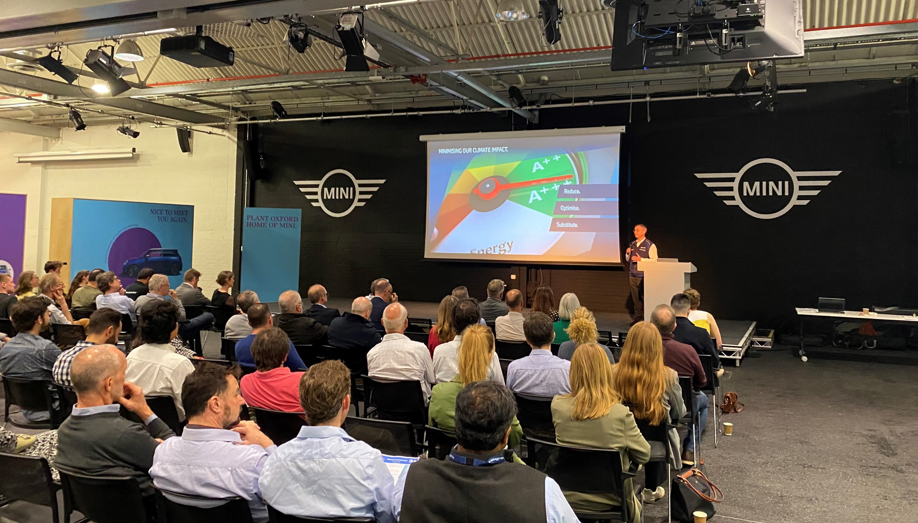
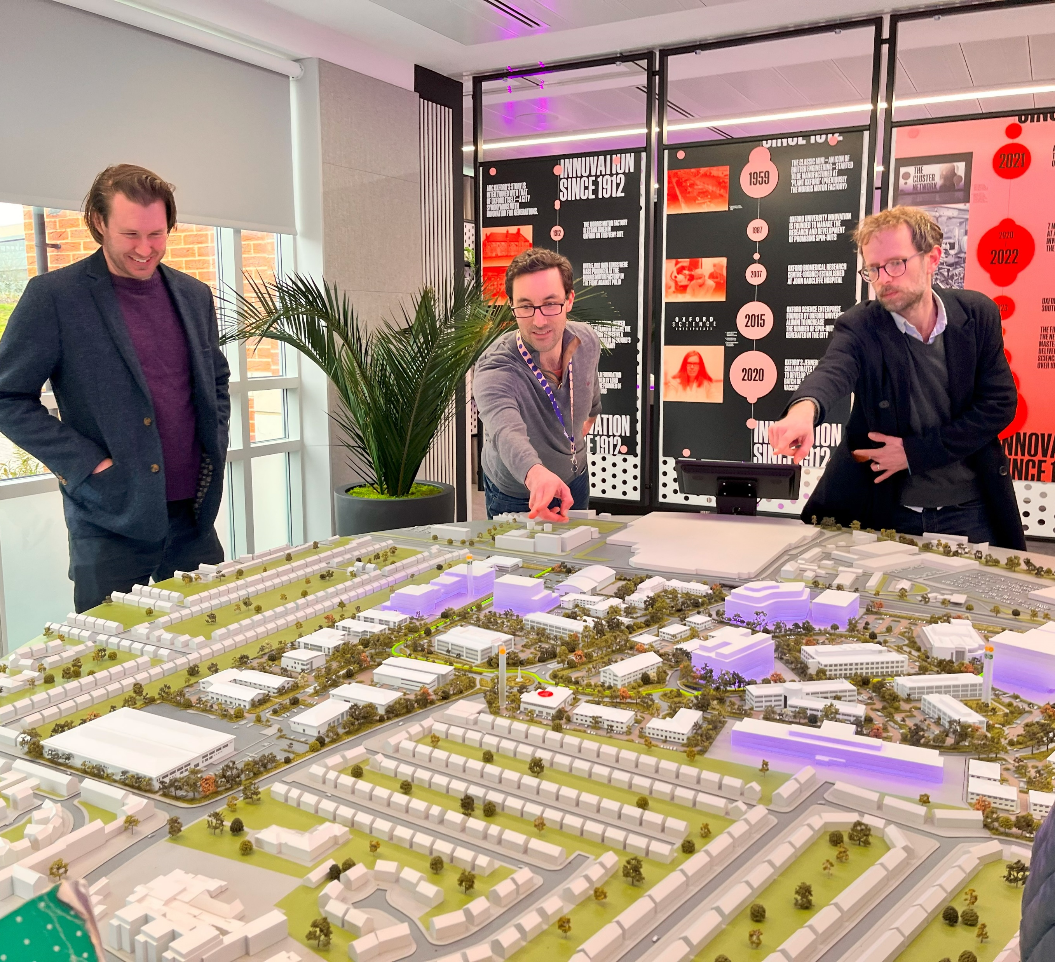
The project has delivered a clear, collaborative vision and strategy to efficiently achieve industrial decarbonisation by 2040
The Oxford Industrial Cluster will be established under ZCOP to implement this Local Industrial Decarbonisation Roadmap, with 16 targeted actions identified to be pursued by three ZCOP working groups – Energy Supply Infrastructure, Collaborative Financing, and Capacity Building. Collectively, these actions will support the delivery of key milestones along a shared journey to net zero industrial emissions by 2040.
Oxford is a unique industrial cluster with high ambitions for which collaboration is key as:
While Mini Plant Oxford may require bespoke solutions to decarbonise, it has synergies in the barriers faced by business parks – requiring upgraded grid capacity and improved renewable energy infrastructure.
While business parks may have already developed their strategies, they face similar landlord-tenant related barriers that SMEs may encounter.
To foster a collaborative ecosystem of stakeholders and overcome shared challenges the Oxford Industrial Cluster will need to engage actively with other sectors under ZCOP to exploit synergies between domestic, commercial, institutional and transport decarbonisation.​ For more information on the Oxford Industrial Cluster or how to join ZCOP, contact zcop@oxford.gov.uk or visit https://zerocarbonoxford.org.
Zero Carbon Oxford Partnership benefits:
Support delivery of ESG Goals
Connect with like-minded organisations and experts
Participate in collaborative projects
Local & national policy influence
Recognition and visibility
By being part of ZCOP, members of will be able to access a wide network of expertise and activities in industrial, domestic, commercial, institutional and transport decarbonisation.​ ZCOP's strong reputation and track record strengthens benefits of industrial's participation in the Oxford Industrial Cluster. 24 organisations, including BMW Group, Unipart, ARC Oxford, and Oxfordshire Greentech, are already part of ZCOP.

